Slide 1

Vibe coding and Working with Gen-AI APIs
Omar Abdallah
ommohamed@iti.gov.eg
Hany Saad
hghiett@iti.gov.eg

Slide 2
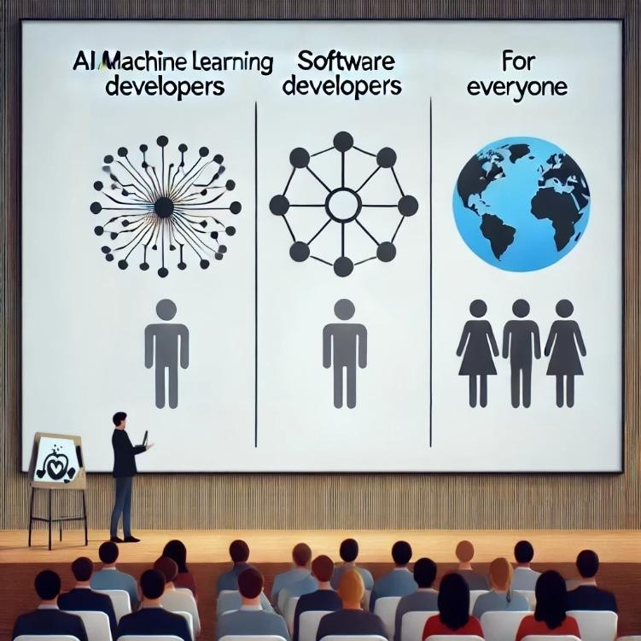
Why should we learn about Gen AI?
AI / Machine Learning Developers:
Design and refine Generative AI models to create more intelligent and efficient AI-driven solutions.
Software Developers:
Utilize AI tools to enhance productivity in development tasks.
Leverage Generative AI APIs to build AI-powered applications
Everyone:
In today’s AI-centric world, it’s crucial for individuals across all professions to grasp the basics of Generative AI and incorporate AI tools into their workflows to boost productivity.

Slide 3
Gen-AI based startups and real products
Use cases for real products using Gen AI:
Loop-x (AI Agents for different roles): https://loop-x.co
Gemelo ai (Twin AI creator): https://gemelo.ai
Apriora AI (Recruitment and Interviews): https://www.apriora.ai
Velents AI (Recruitment and Interviews): https://www.velents.com
Nancy AI (Recruitment and Interviews): https://nancy-ai.com
Mariana AI (Medical): https://marianaai.com

Slide 4
Working with Gen-AI APIs

Slide 5
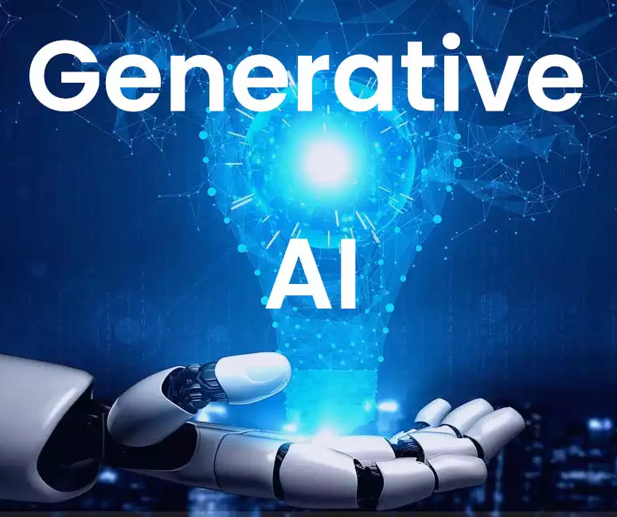
Working with Gen AI APIs
OpenAI Models
DeepSeek AO Models
Google AI Models
Anthropic AI Models
Qwen AI Models
MS Azure OpenAI Service
Hugging Face Platform
MS Azure AI Models
GitHub Models

Slide 6
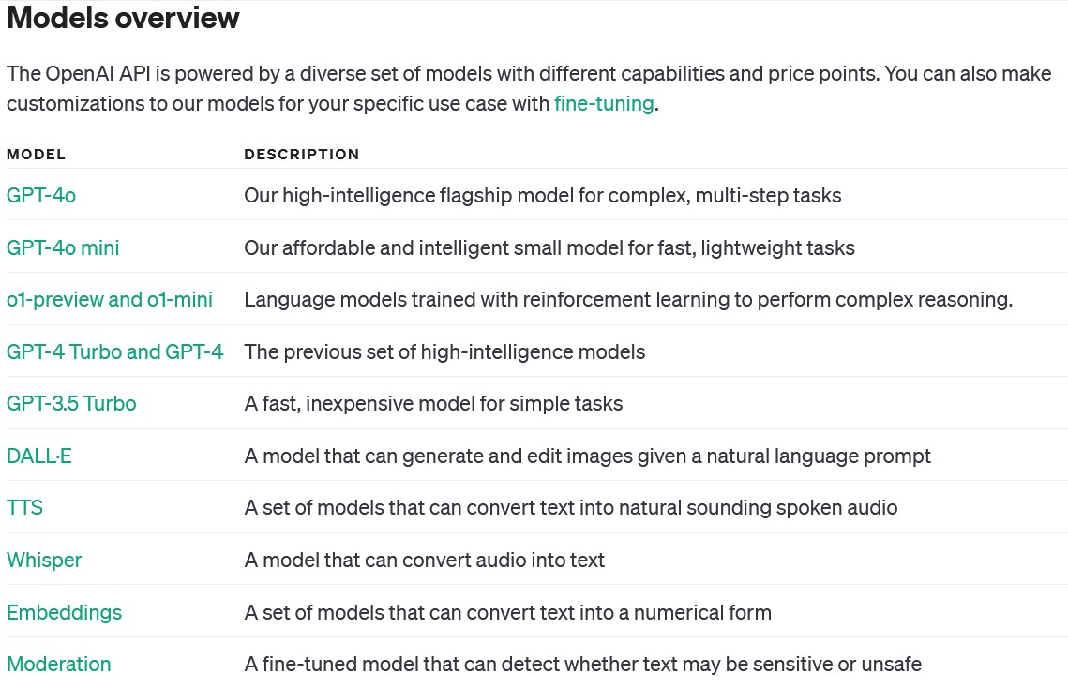
Models and Capabilities
OpenAI
Models
https://platform.openai.com/docs/models

Slide 7
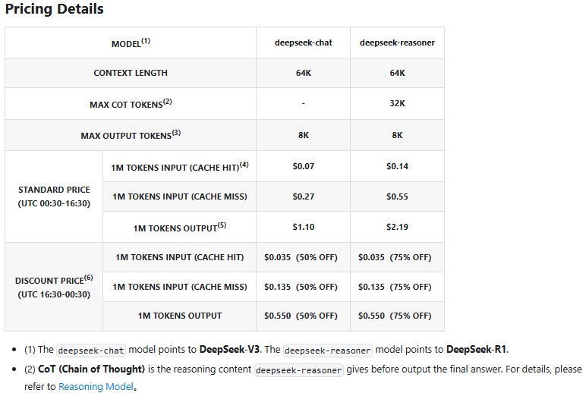
Models and Capabilities
DeepSeek
AI Models
https://apidocs.deepseek.com/quick_start/pri cing

Slide 8
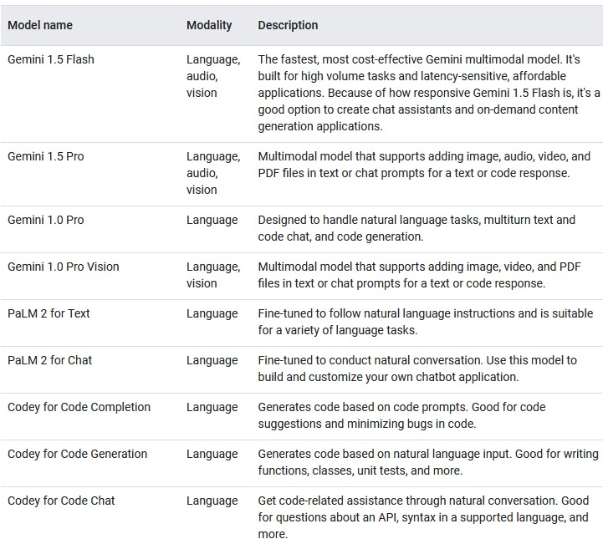
Models and Capabilities
Google AI
Models
https://deepmind.google/models/

Slide 9
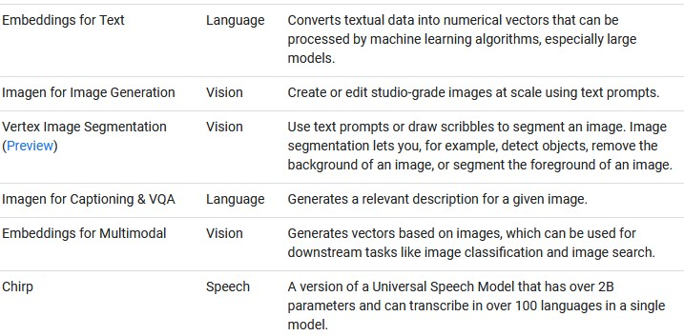
Models and Capabilities
Google AI
Models
https://deepmind.google/models/

Slide 10
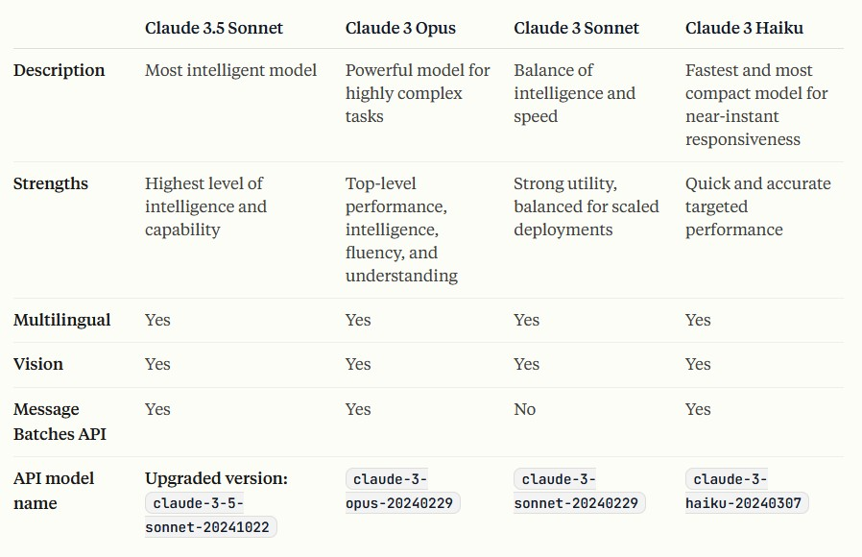
Models and Capabilities
Anthropic
AI Models
https://docs.anthropic.com/en/docs/about-claude/models/overview

Slide 11
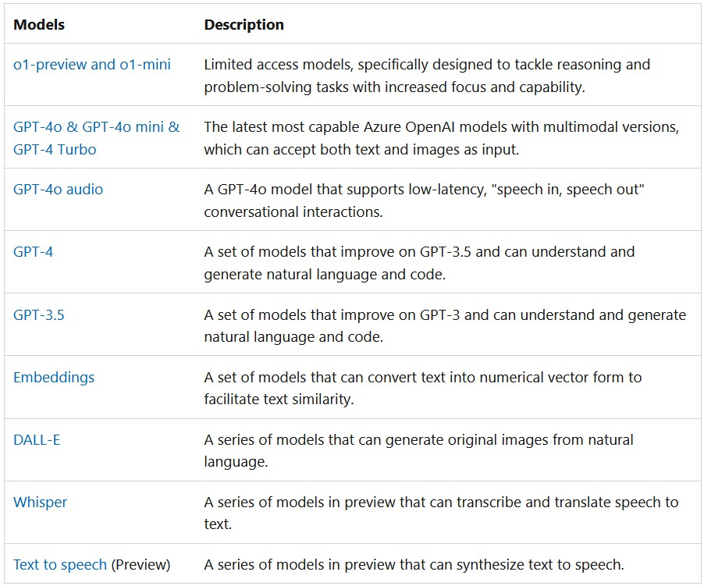
Models and Capabilities
MS Azure
OpenAI
Service
https://azure.microsoft.com/en-us/products/ai-services/openai-service

Slide 12
Open Source Models

Slide 13
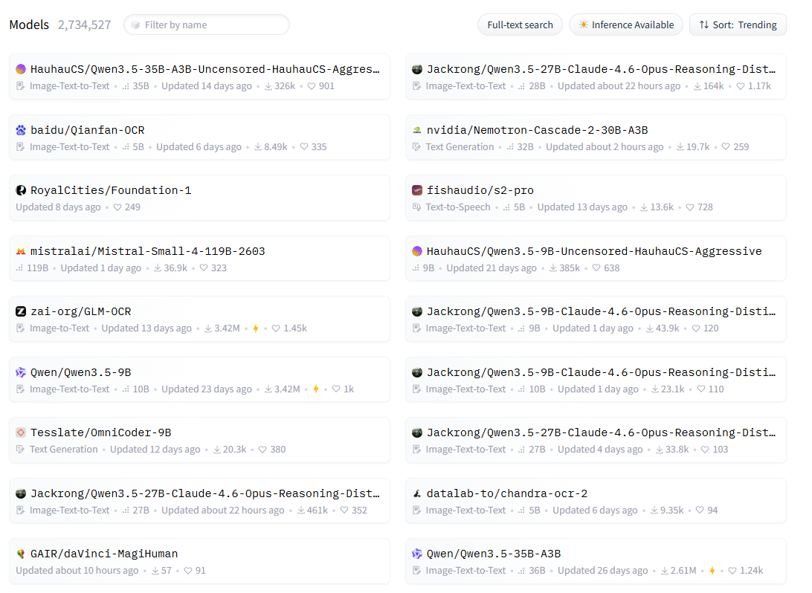
Models and Capabilities
Hugging
Face
Models
https://huggingface.co/models

Slide 14
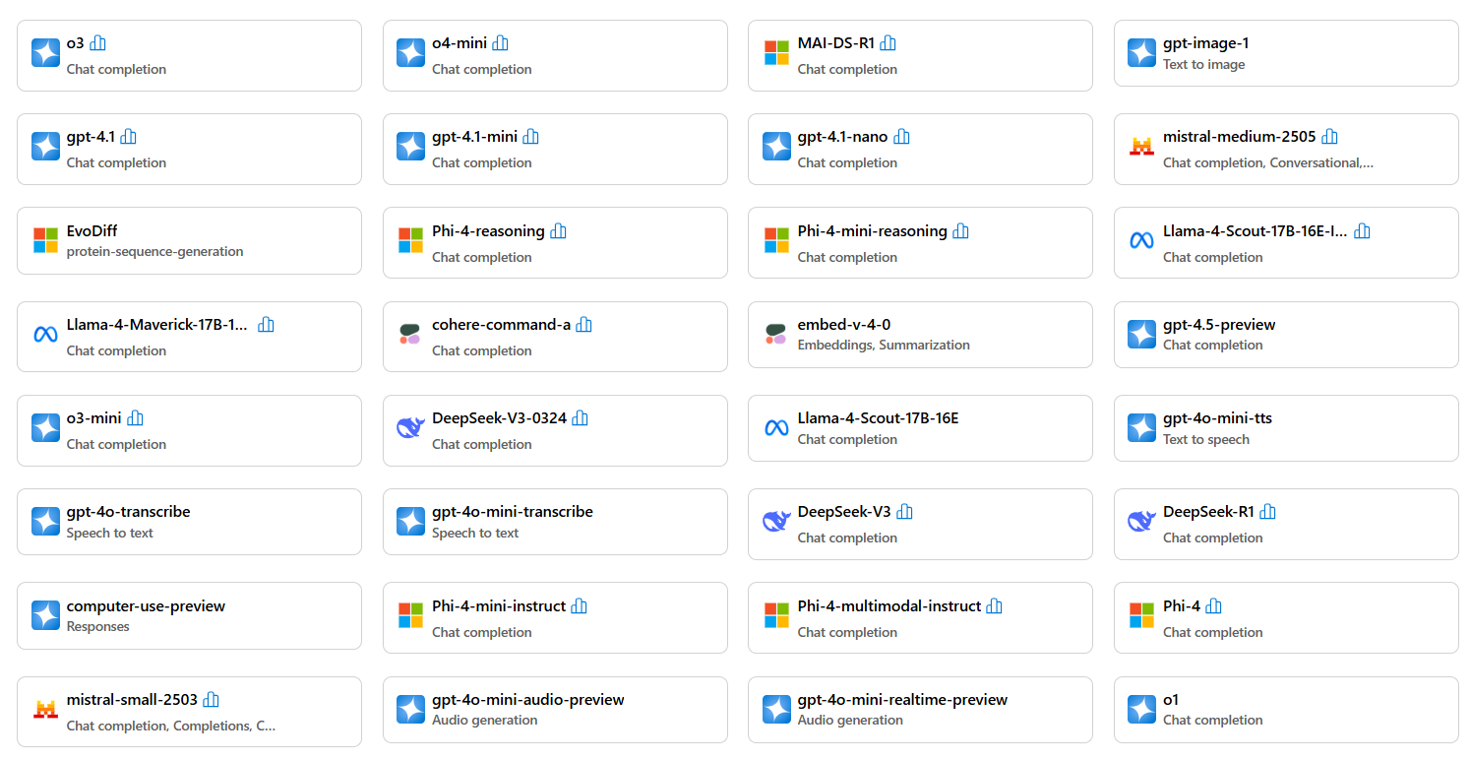
Models and Capabilities
MS Azure
AI Models
https://ai.azure.com/explore/models

Slide 15
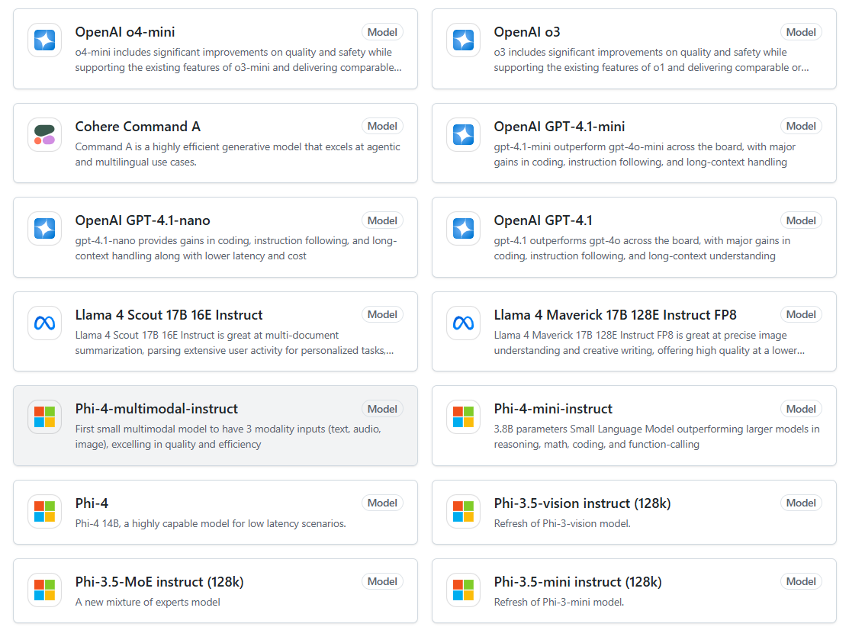
Models and Capabilities
GitHub
AI Models
https://github.com/marketplace/models

Slide 16
OpenAI APIs

Slide 17
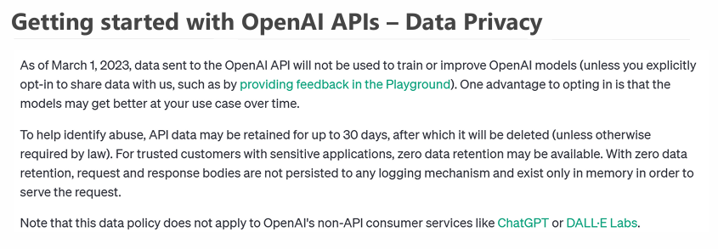
OpenAI APIs

Slide 18
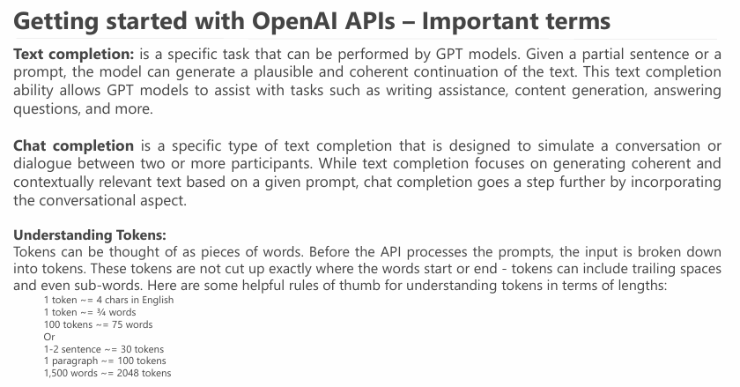
OpenAI APIs

Slide 19
OpenAI APIs
Getting started:
First, you need to create an OpenAI account.
Go to OpenAI platform
Create API_Key from here
Finally, you can access the APIs as REST APIs from here, or you can use provided libraries for different languages here
Documentation and pricing:
OpenAI API models pricing.
OpenAI APIs Docs.
API Reference
OpenAI Examples.
OpenAI Cookbook
How to work with APIs
Using Language specific SDK
Using REST API

Slide 20
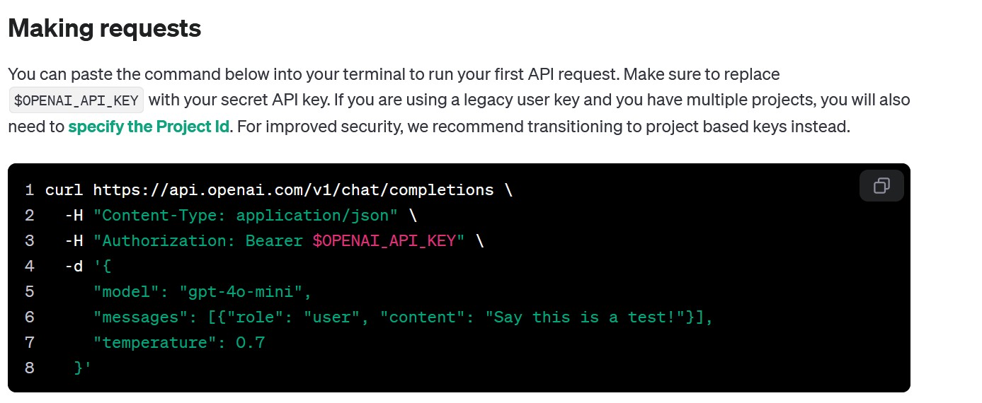
OpenAI APIs
https://platform.openai.com/docs/api-reference/chat/create

Slide 21
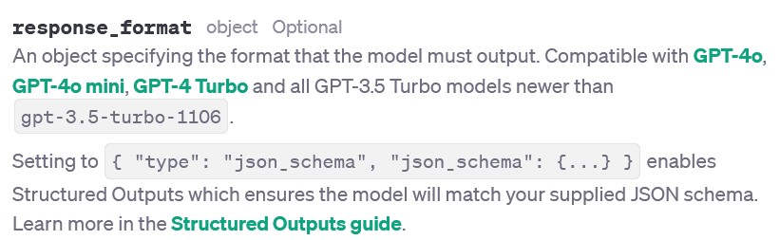
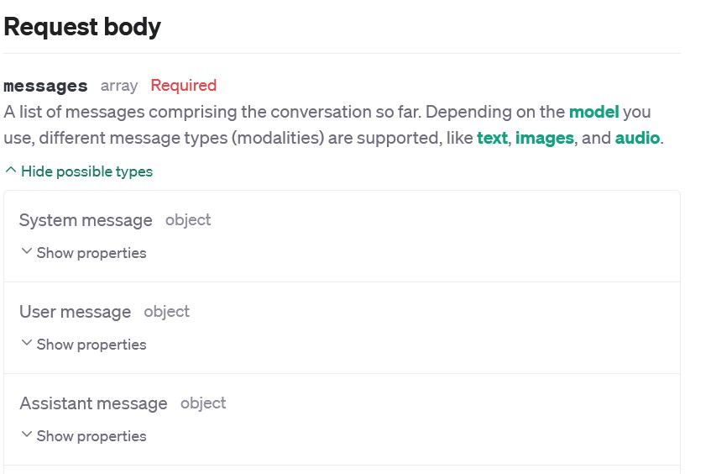
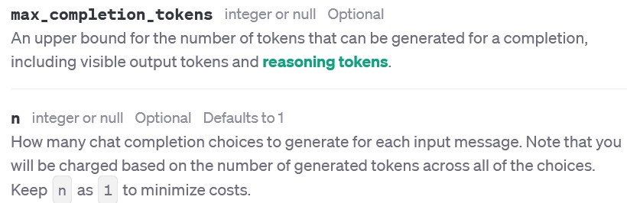
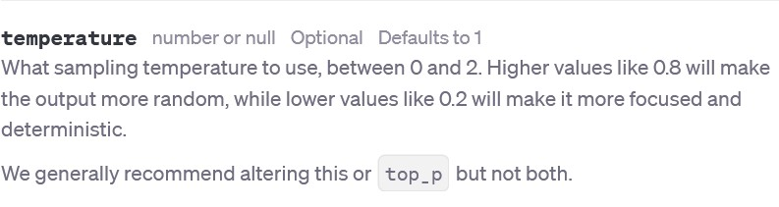
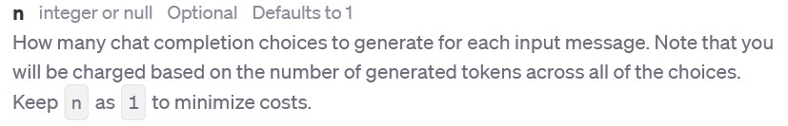
OpenAI APIs

Slide 22
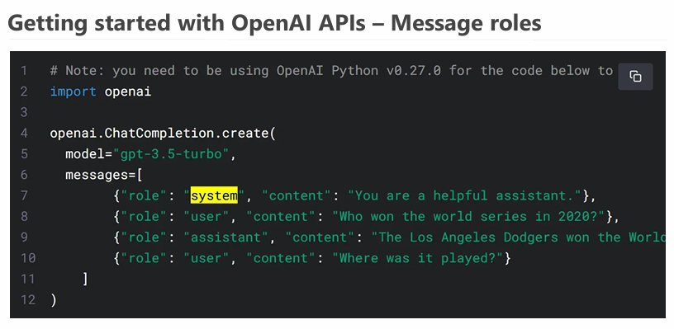
OpenAI APIs

Slide 23
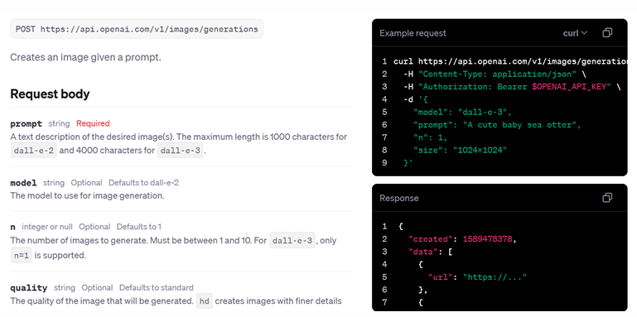
OpenAI APIs
OpenAI APIs – Image generation (API Reference)

Slide 24
Online courses resources
Different learning paths

Slide 25
Resources (DeepLearning.ai – Free)
Python intro (Optional):
AI Python for Beginners: https://www.deeplearning.ai/short-courses/ai-python-for-beginners/
Prompt engineering for Devs, OpenAI APIs
ChatGPT Prompt Engineering for Developers: https://www.deeplearning.ai/short-courses/chatgpt-prompt-engineering-for-developers/
Building Systems with the ChatGPT API: https://www.deeplearning.ai/short-courses/building-systems-with-chatgpt/
Reasoning with o1: https://www.deeplearning.ai/short-courses/reasoning-with-o1/
Open-Source models & Hugging-face:
Open-Source Models with Hugging Face: https://www.deeplearning.ai/short-courses/open-source-models-hugging-face/
Introducing Multimodal Llama 3.2: https://www.deeplearning.ai/short-courses/introducing-multimodal-llama-3-2/
Ollama – Run LLM Locally:
Learn Ollama in 15 Minutes - Run LLM Models Locally for FREE (YouTube): https://www.youtube.com/watch?v=UtSSMs6ObqY
Ollama Course – Build AI Apps Locally (YouTube – Intermediate - Optional): https://www.youtube.com/watch?v=GWB9ApTPTv4
LangChain, RAG, AI Agents:
LangChain for LLM Application Development: https://www.deeplearning.ai/short-courses/langchain-for-llm-application-development/
LangChain: Chat with Your Data: https://www.deeplearning.ai/short-courses/langchain-chat-with-your-data/
AI Agents in LangGraph (Intermediate): https://www.deeplearning.ai/short-courses/ai-agents-in-langgraph/
Functions, Tools and Agents with LangChain (Intermediate): https://www.deeplearning.ai/short-courses/functions-tools-agents-langchain/
AI Agent and multi-agent:
Multi AI Agent Systems with crewAI (Beginner): https://www.deeplearning.ai/short-courses/multi-ai-agent-systems-with-crewai/
AI Agentic Design Patterns with AutoGen (Beginner – Optional): https://www.deeplearning.ai/short-courses/ai-agentic-design-patterns-with-autogen/
RAG (Intermediate):
Building and Evaluating Advanced RAG Applications: https://www.deeplearning.ai/short-courses/building-evaluating-advanced-rag/
Building Multimodal Search and RAG: https://www.deeplearning.ai/short-courses/building-multimodal-search-and-rag/
RAG using LlamaIndexL (Optional):
Building Agentic RAG with LlamaIndex: https://www.deeplearning.ai/short-courses/building-agentic-rag-with-llamaindex/
JavaScript RAG Web Apps with LlamaIndex: https://www.deeplearning.ai/short-courses/javascript-rag-web-apps-with-llamaindex/
Other (Optional):
How Transformer LLMs Work: https://www.deeplearning.ai/short-courses/how-transformer-llms-work/
Generative AI for Software Development: https://www.deeplearning.ai/courses/generative-ai-for-software-development/

Slide 26
Resources (YouTube - Free)
YouTube Playlists (Free)
Generative AI in a Nutshell: https://www.youtube.com/watch?v=2IK3DFHRFfw-
Generative AI Tools (From Edureka): https://www.youtube.com/watch?v=gMa_QHSAxOY&list=PL9ooVrP1hQOFIOOkGN2gbjvse8jcz-mux
Introduction to Generative AI and LLMs (From Microsoft, covering intro RAG, Fine Tuning, and most dev topics): https://www.youtube.com/playlist?list=PLlrxD0HtieHj2nfK54c62lcs3-YSTx3Je
RAG:
Learn RAG From Scratch – Python AI Tutorial from a LangChain Engineer: https://www.youtube.com/watch?v=sVcwVQRHIc8
AI Agents:
How To Create Ai Agents From Scratch (CrewAI, Zapier, Cursor): https://www.youtube.com/watch?v=PM9zr7wgJX4
The Complete Guide to Building AI Agents for Beginners: https://www.youtube.com/watch?v=MOyl58VF2ak
Python Advanced AI Agent Tutorial - LlamaIndex, Ollama and Multi-LLM!: https://www.youtube.com/watch?v=JLmI0GJuGlY
ADVANCED Python AI Agent Tutorial - Using RAG: https://www.youtube.com/watch?v=ul0QsodYct4
GitHub Copilot for developers (From Microsoft): https://www.youtube.com/playlist?list=PLlrxD0HtieHgr23PS05FIncnih4dH9Na5
Ollama:
Learn Ollama in 15 Minutes - Run LLM Models Locally for FREE (YouTube): https://www.youtube.com/watch?v=UtSSMs6ObqY
Ollama Course – Build AI Apps Locally (YouTube – Intermediate - Optional): https://www.youtube.com/watch?v=GWB9ApTPTv4
Other (Optional):
Advanced Dev topics + Practical project (From FreeCodeCamp.org): https://www.youtube.com/watch?v=mEsleV16qdo
Generative AI for Developers – Comprehensive Course: https://www.youtube.com/watch?v=F0GQ0l2NfHA
AI Agents: https://www.youtube.com/watch?v=7WK0w9Z9mPE

Slide 27
Resources (Microsoft - Free)
Microsoft free courses (Free):
Generative AI for Beginners
Generative AI for Beginners - .NET
Generative AI with JavaScript
AI for Beginners
AI Agents for Beginners - A Course
Data Science for Beginners
ML for Beginners
Mastering GitHub Copilot for C#/.NET Developers
Mastering GitHub Copilot for Paired Programming

Slide 28
Thank You
https://www.linkedin.com/in/omar-abdallah-abdelrahman/

